Slide 1
Title
Giovanni A. Crestani
PhD Student at Burke Lab
Oregon State University
crestang@oregonstate.edu
Event name
Location, Date

Slide 2
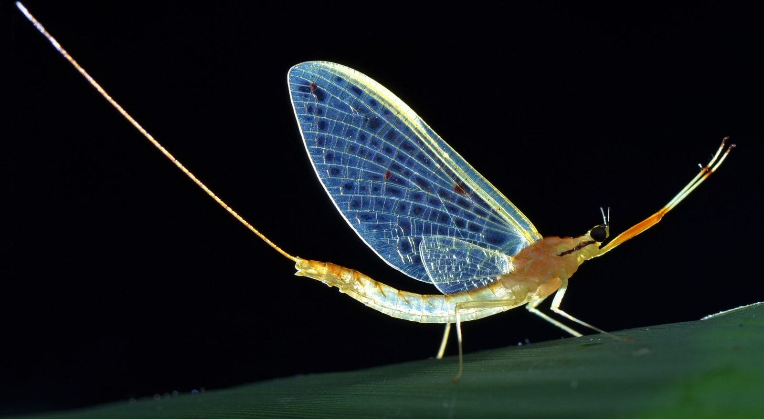
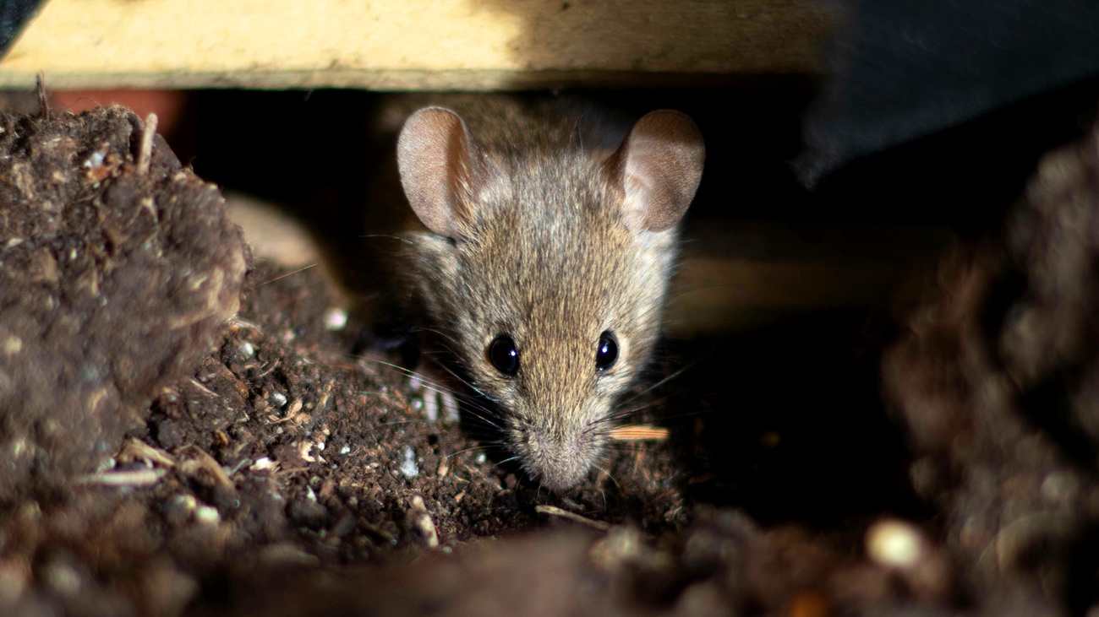
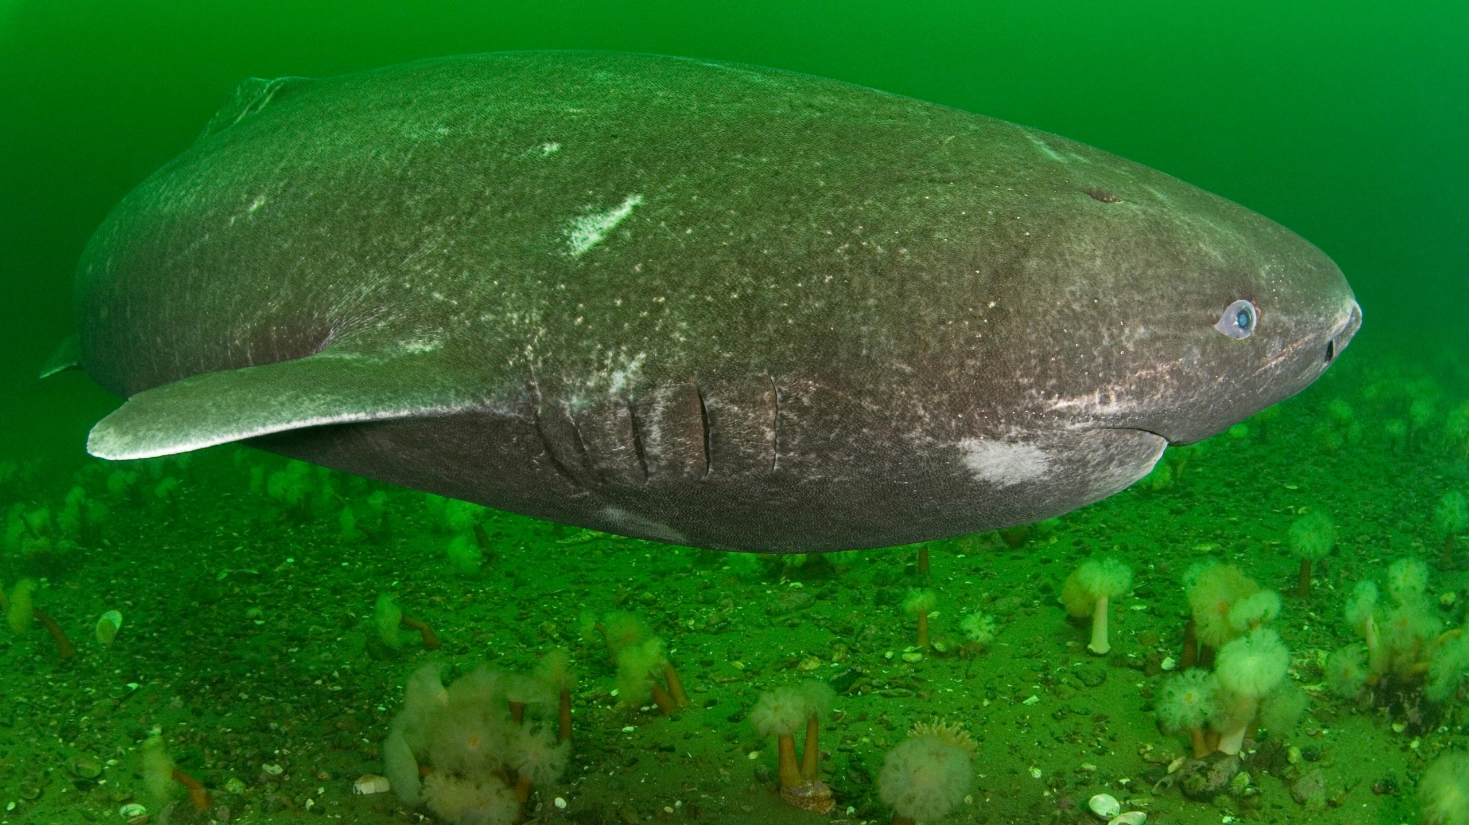
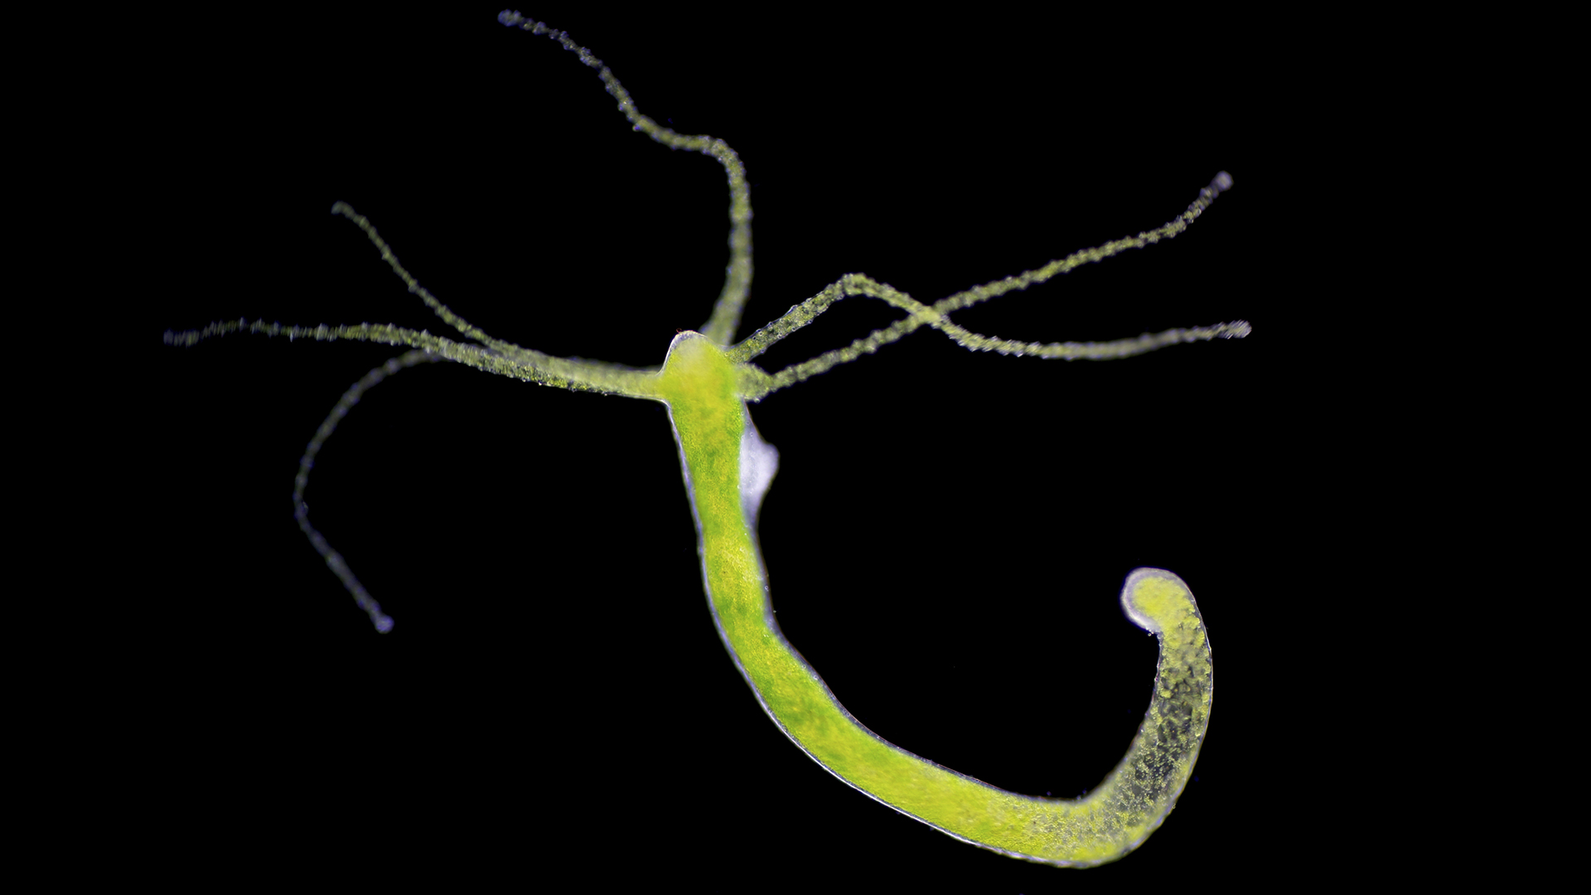
Aging and longevity varies considerably across the tree of life. Why?
Lives a few hours
12 months
250+ years
Virtually immortal?
How does evolution shape those patterns?
Why don’t all organisms evolve to be very long-lived?

Slide 3
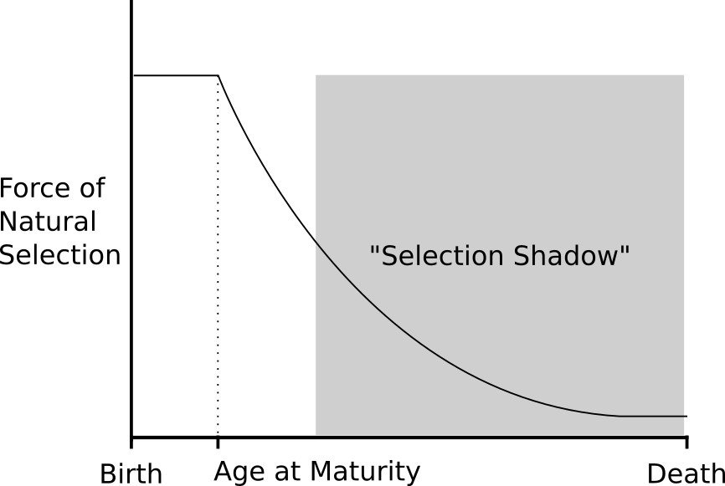
Evolutionary Theory of Aging
Hamilton, 1966
Medawar, 1958
Adapted from: Fabian, D. & Flatt, T. (2011) The Evolution of Aging. Nature Education Knowledge 3(10):9
Notes:
(Hamilton, 1966; Medawar, 1958; Williams, 1957)

Slide 4
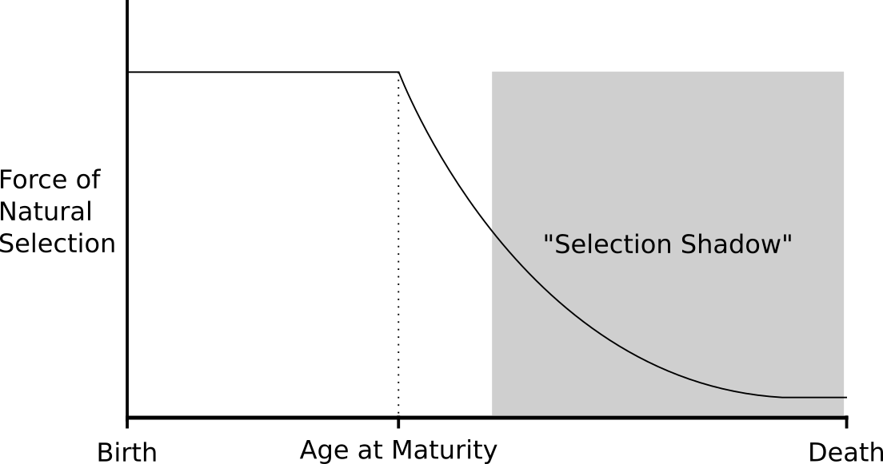
Adapted from: Fabian, D. & Flatt, T. (2011) The Evolution of Aging. Nature Education Knowledge 3(10):9

Slide 5
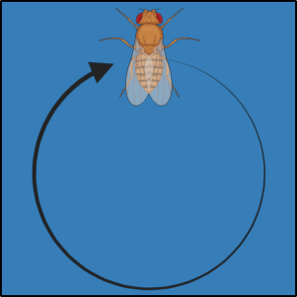
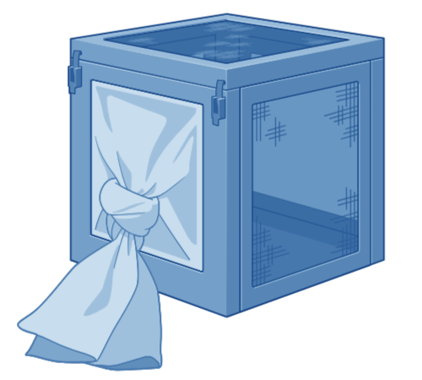
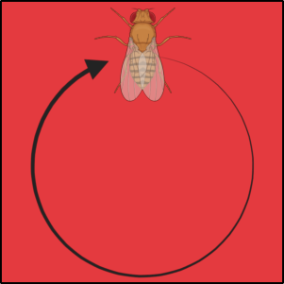


"Old"
Only 70-day-old flies produce the next generation.
O-type
70-day generations
x10
“Baseline”
Only 14-day-old flies produce the next generation.
B-type
14-day generations
x10

Slide 6
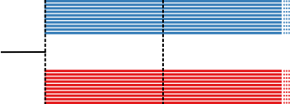
"Old"
Only 70-day-old flies produce the next generation.
O-type
70-day generations
Genotypic data
Phenotypic & Genotypic data
x10
“Baseline”
Only 14-day-old flies produce the next generation.
B-type
14-day generations
Generation 01
2018
Generation 20
2022
Generation 42
2025
x10

Slide 7


"Old"
Only 70-day-old flies produce the next generation.
Pooled population sequencing,
100 females per population
O-type
70-day generations
Genotypic data
Phenotypic & Genotypic data
x10
“Baseline”
Only 14-day-old flies produce the next generation.
B-type
14-day generations
Generation 01
2018
Generation 20
2022
Generation 42
2025
x10

Slide 8
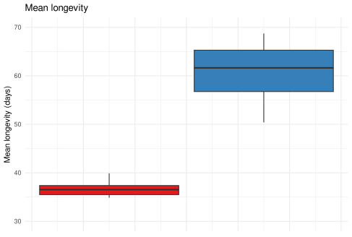
Strong evidence of consistent phenotypic differentiation
B-type
14-day gens.
O-type
70-day gens.

Slide 9
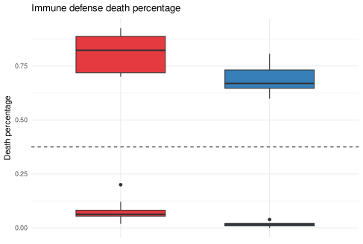
Strong evidence of consistent phenotypic differentiation
B-type
14-day gens.
O-type
70-day gens.

Slide 10
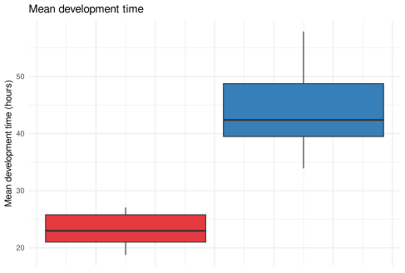
Strong evidence of consistent phenotypic differentiation
B-type
14-day gens.
O-type
70-day gens.

Slide 11
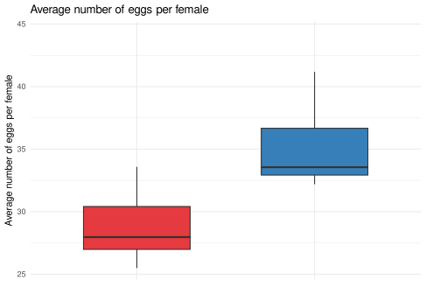
Strong evidence of consistent phenotypic differentiation
B-type
14-day gens.
O-type
70-day gens.

Slide 12
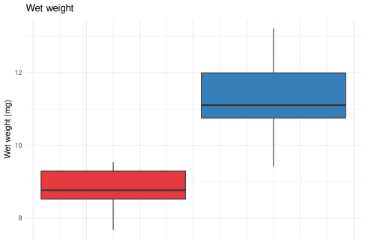
Strong evidence of consistent phenotypic differentiation
B-type
14-day gens.
O-type
70-day gens.

Slide 13
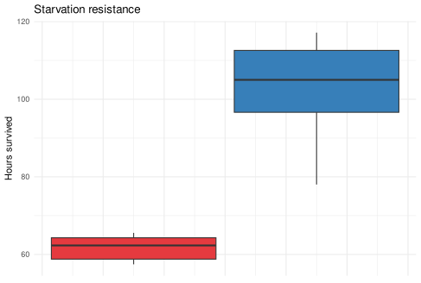
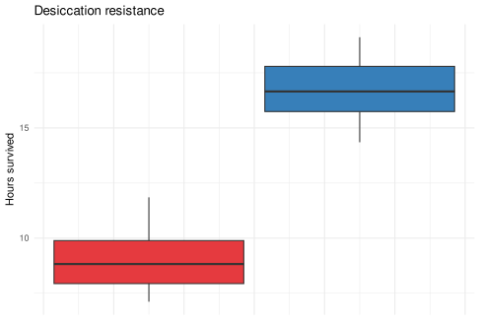
Strong evidence of consistent phenotypic differentiation
B-type
14-day gens.
O-type
70-day gens.

Slide 14
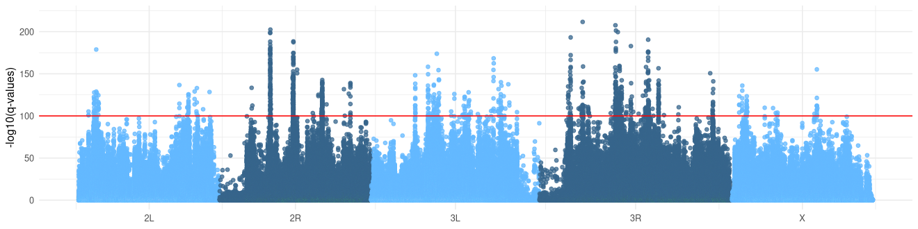
Strong evidence of consistent genomic differentiation
~1 million total SNPs identified

Slide 15
Strong evidence of consistent genomic differentiation
~1 million total SNPs identified
Statistical test applied at each SNP

Slide 16
Strong evidence of consistent genomic differentiation
~1 million total SNPs identified
Statistical test applied at each SNP
~1300 SNPs above significance threshold implicating 300 genes

Slide 17
Strong evidence of consistent genomic differentiation
~1 million total SNPs identified
Statistical test applied at each SNP
~1300 SNPs above significance threshold implicating 300 genes
Genes associated with “neuron projection morphogenesis”, “synapse organization”, and “cell adhesion”

Slide 18

What have we learned...
Evolution can change important traits like longevity fast and consistently

Slide 19
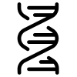
What have we learned...
Evolution can change important traits like longevity fast and consistently
Adaptation for postponed reproduction evokes a polygenic response.

Slide 20

What have we learned...
Evolution can change important traits like longevity fast and consistently
Adaptation for postponed reproduction evokes a polygenic response.
What’s next?
Sequence other generations (gens. 10 and 30)

Slide 21

What have we learned...
Evolution can change important traits like longevity fast and consistently
Adaptation for postponed reproduction evokes a polygenic response.
What’s next?
Sequence other generations (gens. 10 and 30)
Dissect evolutionary dynamics

Slide 22

What have we learned...
Evolution can change important traits like longevity fast and consistently
Adaptation for postponed reproduction evokes a polygenic response.
What’s next?
Sequence other generations (gens. 10 and 30)
Dissect evolutionary dynamics
Explore other —omics (transcriptomics, metabolomics, epigenomics)

Slide 23
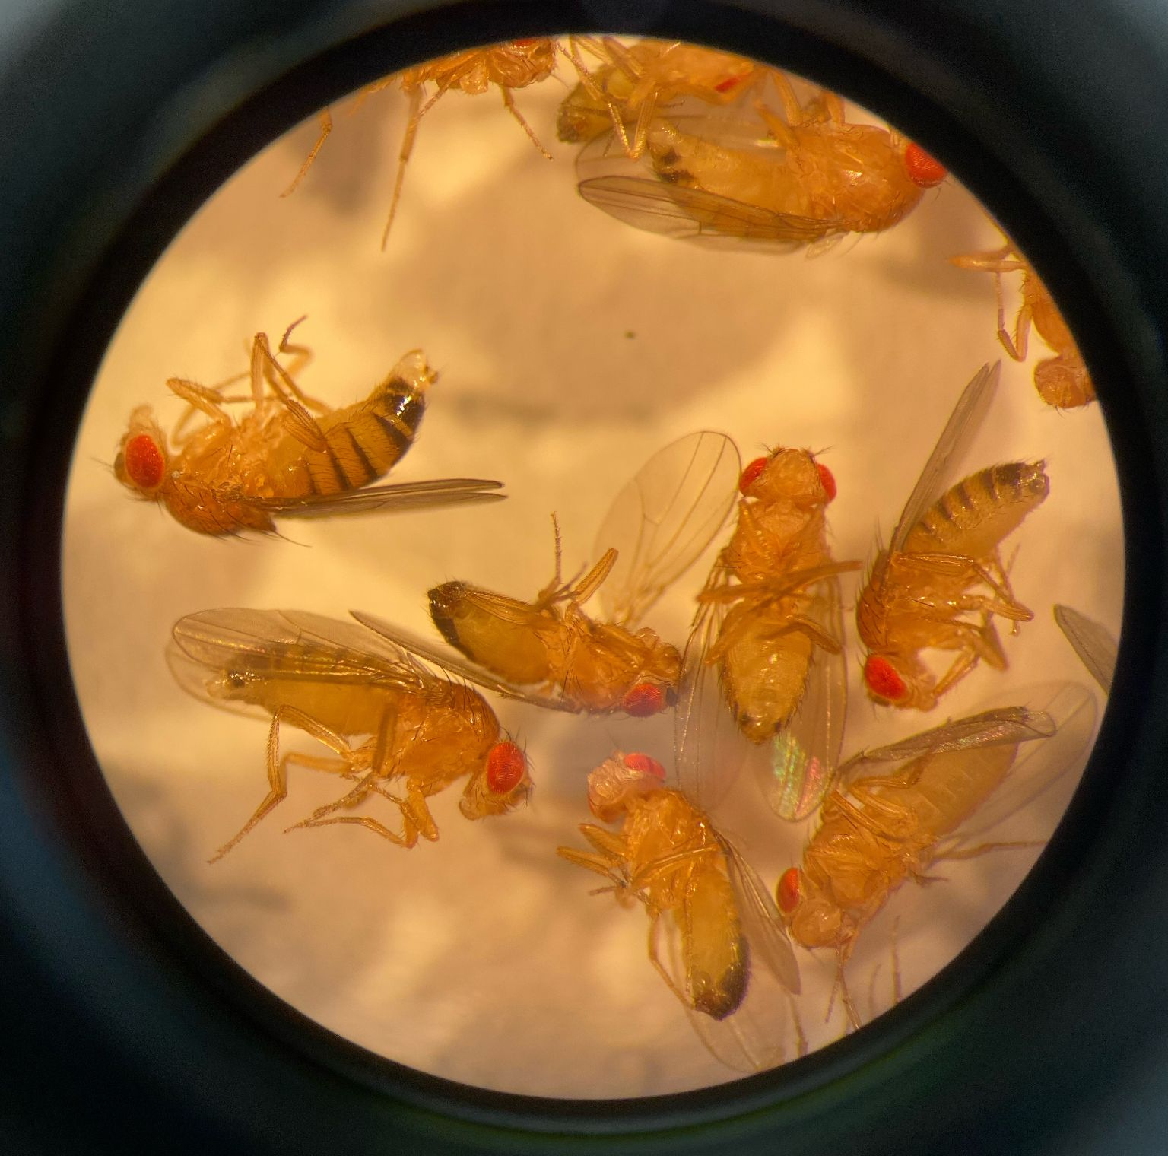
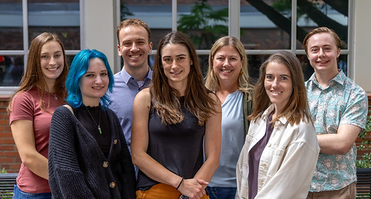


Thank you!
Dr. Molly K. Burke
Dr. Parvin Shahrestani
Hannah S. Dugo
The Burke Lab
Dr. Mark A. Phillips
Dr. Felipe S. Barreto
Dr. David A. Hendrix
Dr. Michael R. Rose
Giovanni A. Crestani
crestang@oregonstate.edu
gacrestani.com

